Slide 1
Healthcare Insurance Provider Fraud Detection
Krunchh Analytics Event Solution

Slide 2
Introduction
Provider Fraud in Medicare is a significant issue, causing a substantial increase in Medicare spending due to fraudulent claims, involving collaboration among providers, physicians, and beneficiaries.
Rigorous data analysis has identified physicians engaging in fraud, often using ambiguous diagnosis codes to justify costly procedures and drugs, impacting insurance companies and leading to rising healthcare costs.
Common forms of healthcare fraud by providers include billing for services not rendered, submitting duplicate claims, misrepresenting services, overcharging for more complex procedures, and billing for uncovered services.

Slide 3
About the Project
The project's objective is to predict potentially fraudulent healthcare providers by analyzing their claims data, aiming to identify important variables that can help in detecting suspicious provider behavior.
Additionally, the project seeks to uncover fraudulent patterns within providers' claims, enabling a deeper understanding of their future behavior and potential fraudulent activities.
The main focus is on developing predictive models and gaining insights into the behavior of healthcare providers to combat fraud in the industry.
This was the PS of Krunch, an Analytical event hosted by DoMS, IIT Madras where my team was among the top 5. This is not the presented solution.

Slide 4
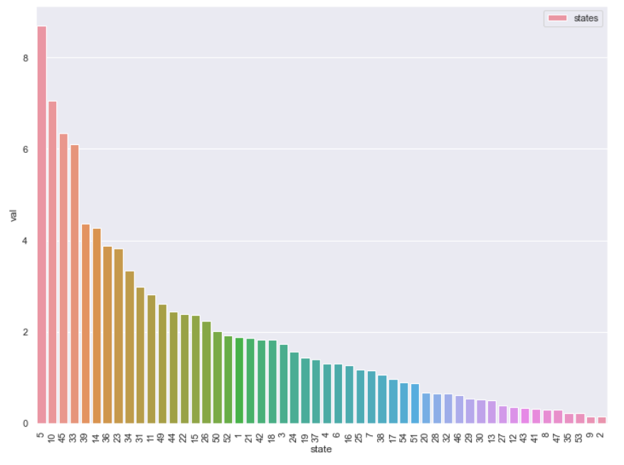
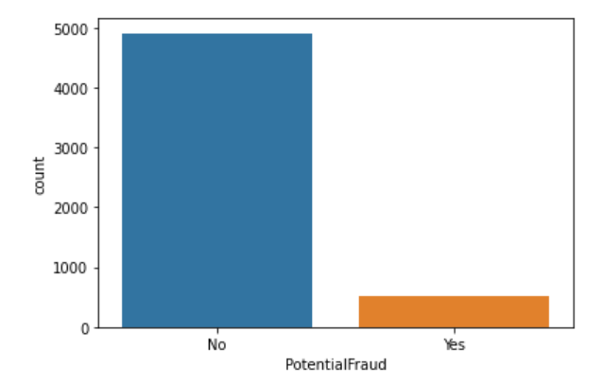
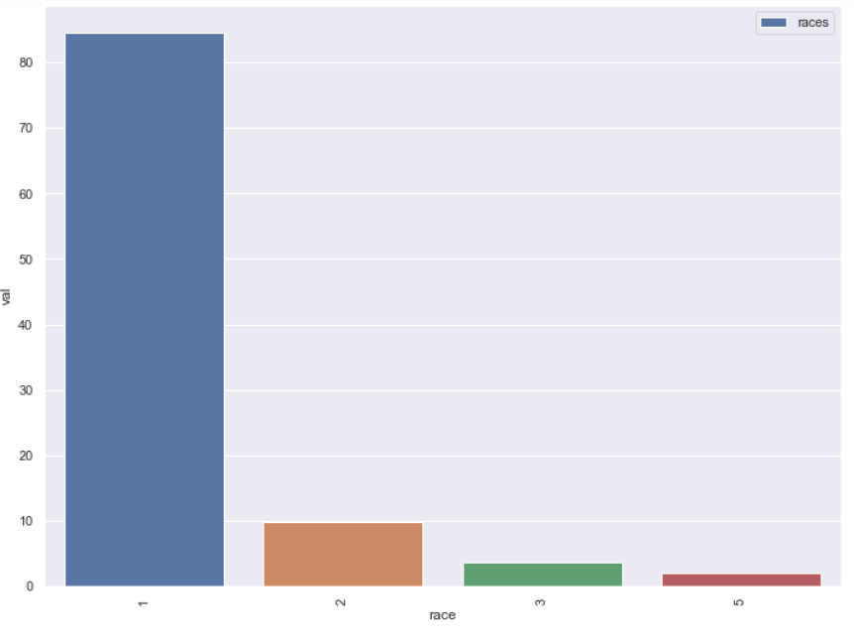
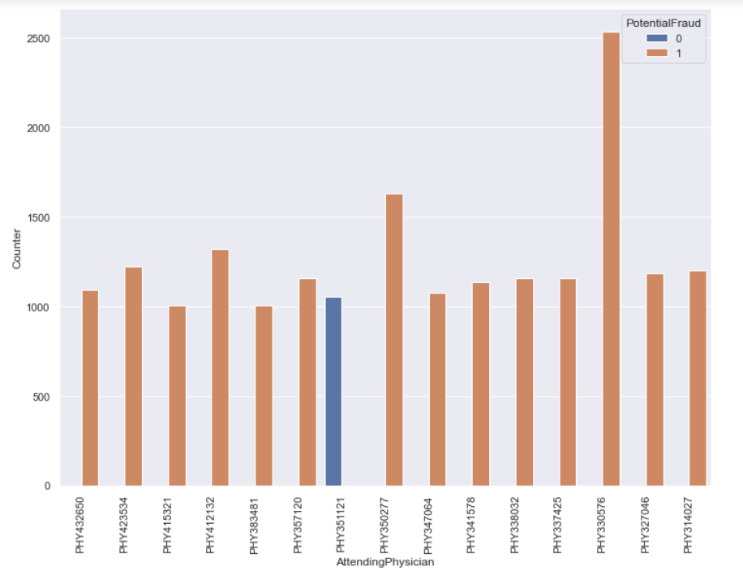
EDA (some examples)
Potential Fraud Cases
category wise
Showing imbalanced dataset
State wise insurance
Claims with Top states for beneficiaries are 5,10,45,33
Race wise insurance claims; dominated by Race 1
Physician linking to fraud; Almost all Physicians are involved

Slide 5
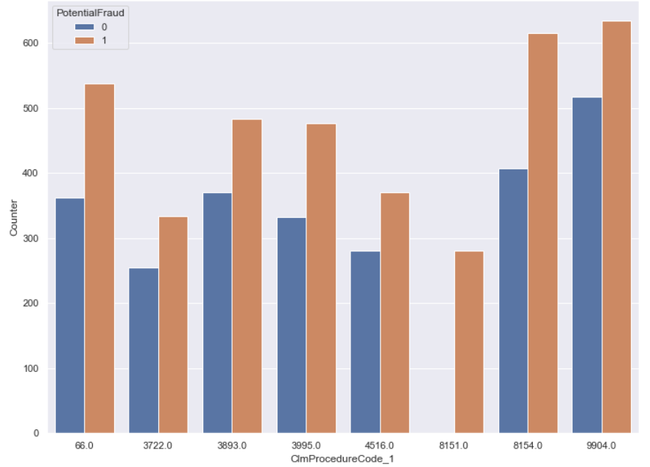
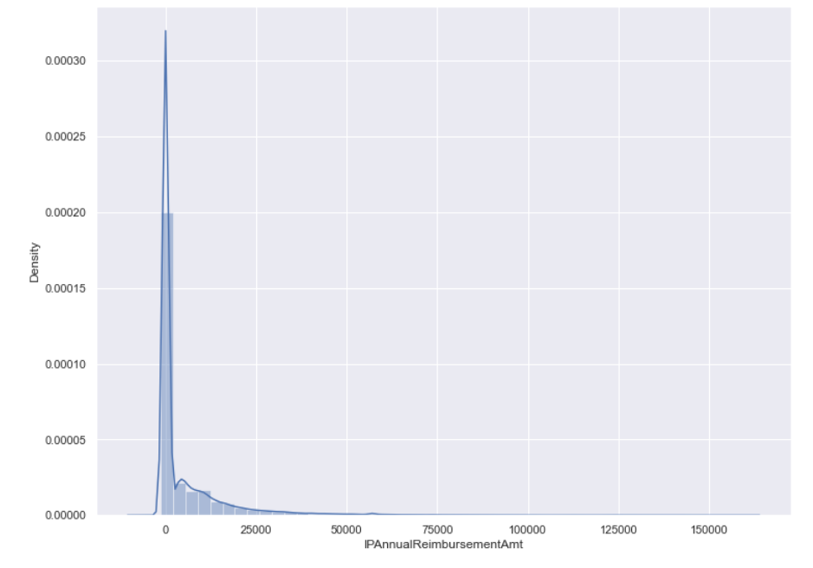
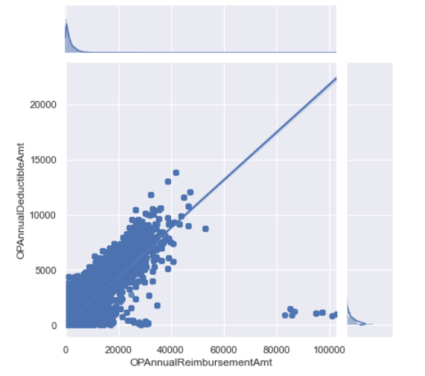
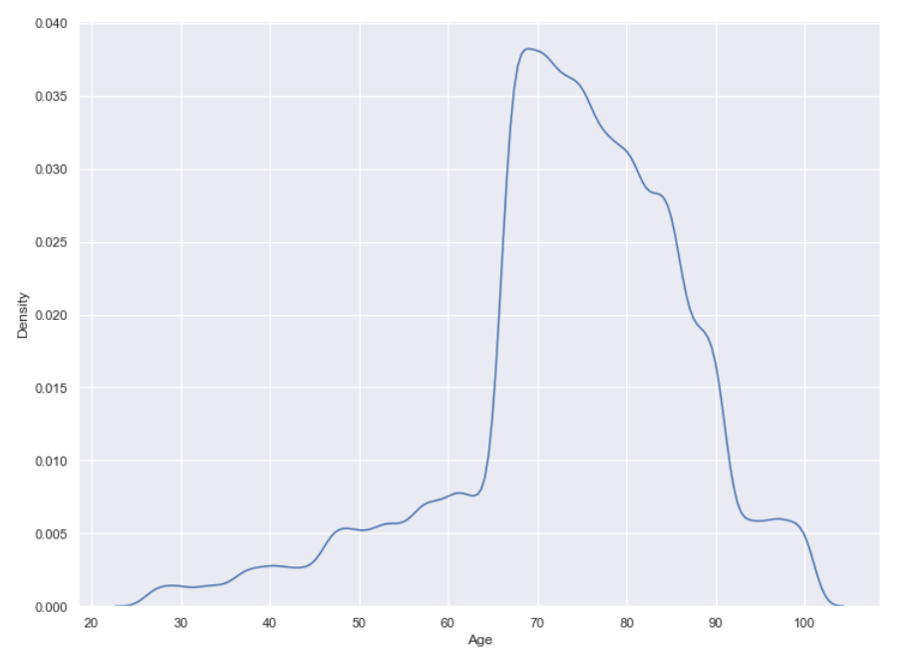
Claim Procedure Code Wise claims; Codes 9904,8154,66 are top codes for frauds.
Distribution of Annual Reimbursement Amount; heavily rightly skewed
Outpatient Reimbursement Amount is positively correlated with Deductible Amount
Age vs claims; age above 70 people dominate with the claims as it is evident that older person is more prone to illness

Slide 6
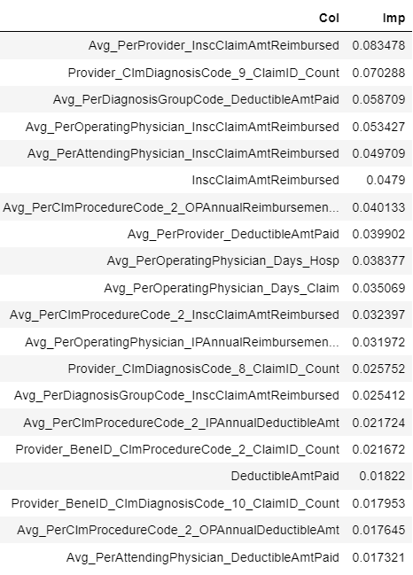
Results
After feature extraction, EDA, feature selection, oversampling it is time to build the supervised machine learning model for classification based on the features present.
Before the results are presented a brief on pipeline. The feature extraction involved creating multiple new features like Age, Number of days in hospital, total amount lost by the insurance firm, etc.
In feature selection following table has been obtained which highlights the importance of feature selection.

Slide 7
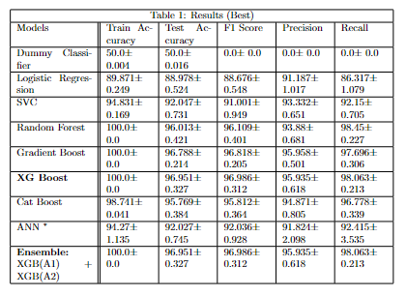
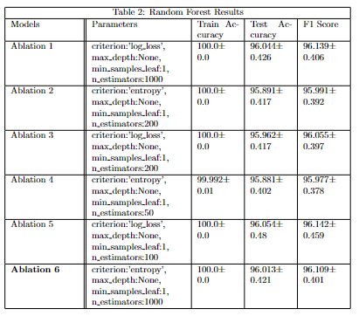
Oversampling takes place using SMOTE (Synthetic Minority Over-sampling Technique) which randomly selects neighbours and interpolates between them to create new samples.

Slide 8
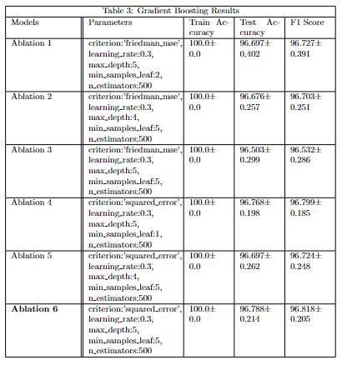
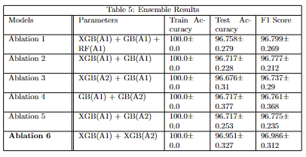
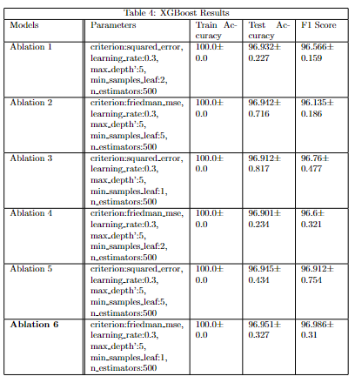

Slide 9
Result Analysis
As we can see Extreme Gradient Boost (XGBoost) classifier is the model with maximum performance and optimal time.
When we use the friedman mse loss, learning rate being 0.3, maximum depth being 5,minimum samples per leaf being 1, and number of estimators being 500 as hyperparameters in this classifier we get 96.951+-0.327 as accuracy.
The second best performance is also provided by the same classifier with different hyperparameters. These include the squared error loss, learning rate being 0.3, maximum depth being 5,minimum samples per leaf being 5, and number of estimators being 500 as hyperparameters in this classifier we get 96.945+- 0.434 as accuracy.

Slide 10
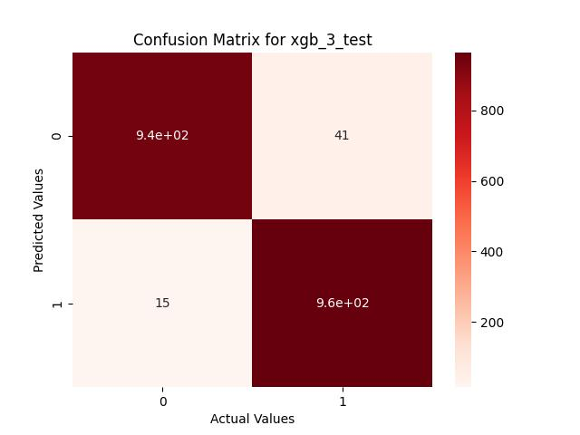

The second best classifier is the Gradient Boost classifier with hyperparameters squared error loss, learning rate 0.3, maximum depth of 5, and number of estimators being 500 which has accuracy of 96.788+-0.214.
As a result we can see that oversampling at the start to make the training balanced along with XGBoost Classifier gives complete performance on training set and high performance on test set.

Slide 11
THANK YOU

